Slide 1
Why NOT Sustainable Development Goals?
Education Beyond SDGs
Helen Kopnina
Northumbria University
Newcastle Business School CCE1
NE1 8ST Newcastle upon Tyne, UK
Google Scholar | ResearchGate | Academia | ORCID | BlueSky | X: @hkopnina

Slide 2
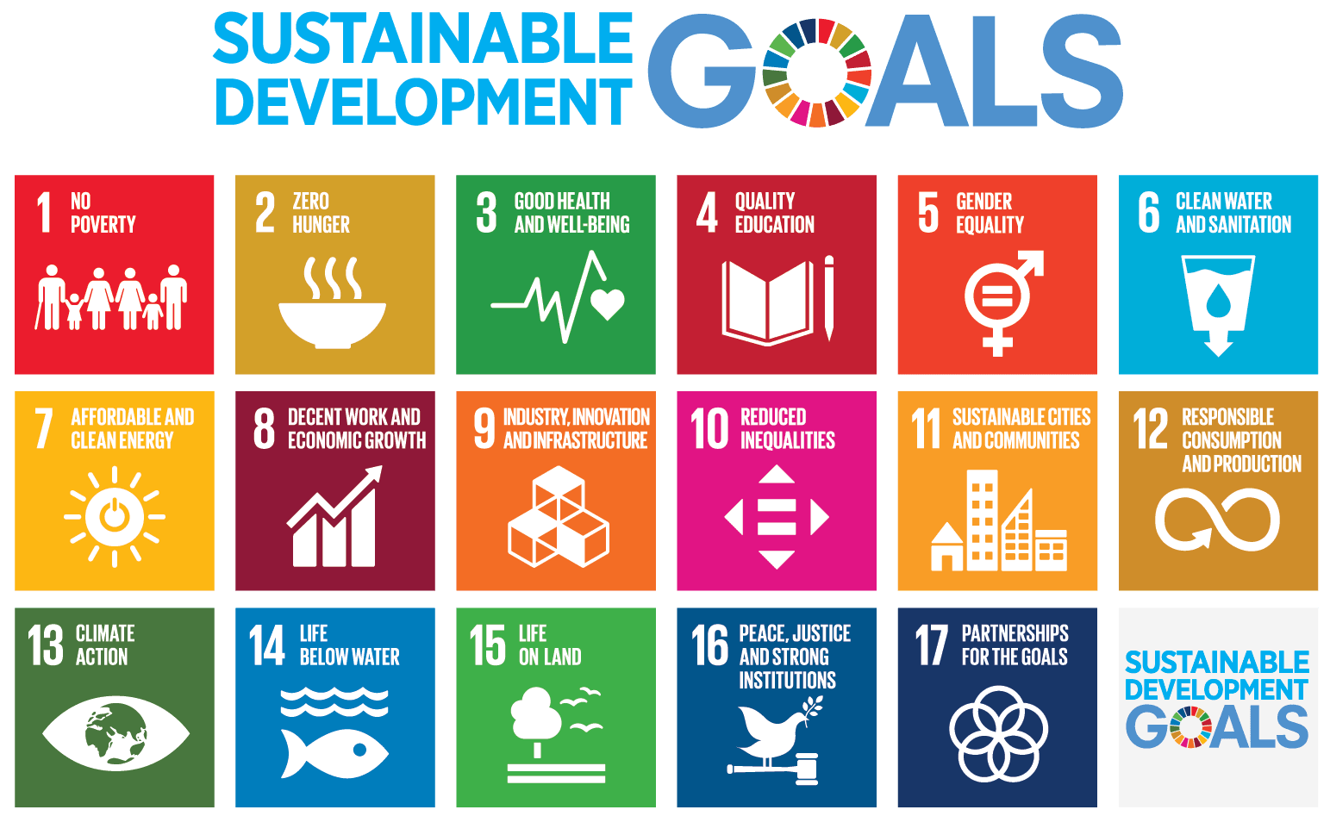


Slide 3
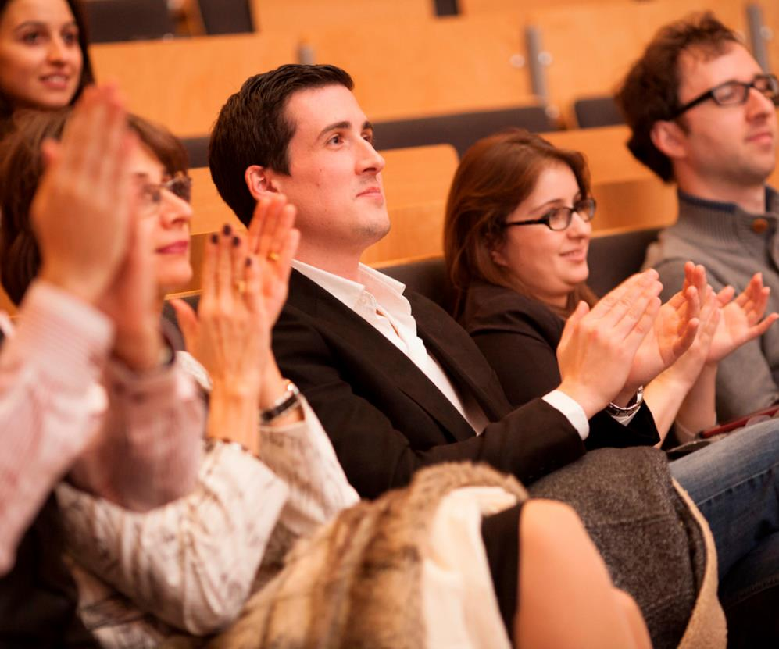
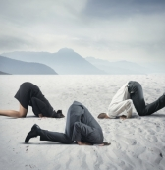
Don’t clap just yet

Slide 4
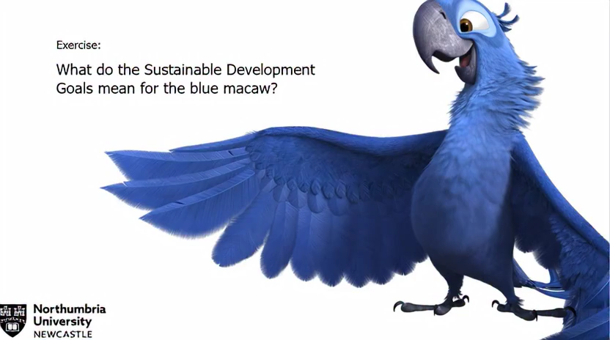

Slide 5
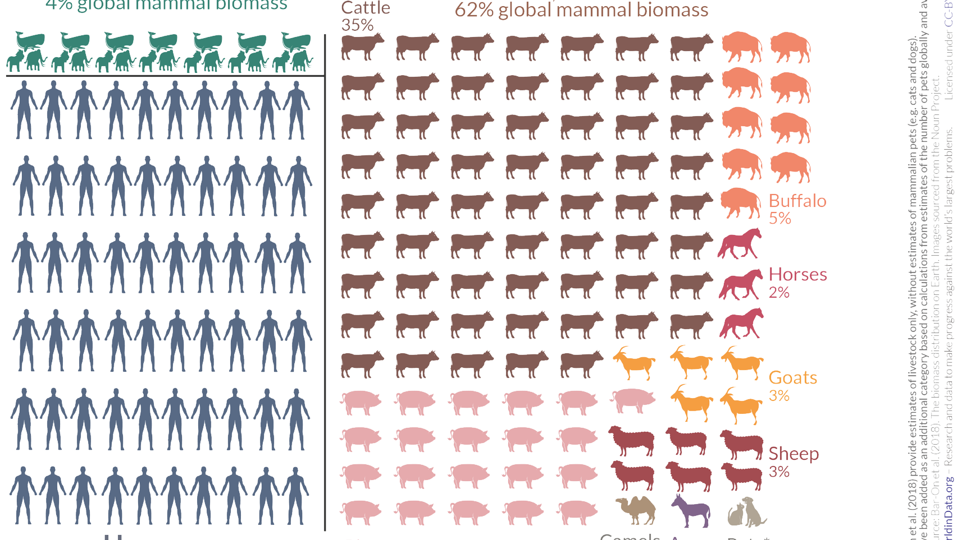

Slide 6
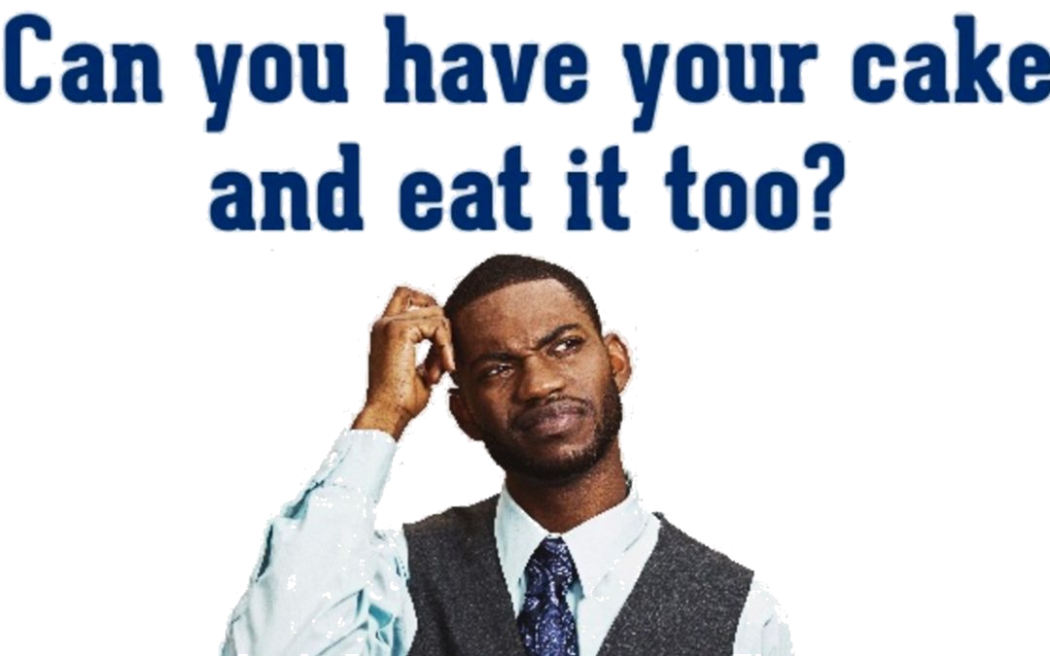
Sustainable development goals: Growing a wealthy and healthy population AND environmental integrity all at once?

Slide 7
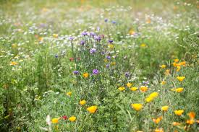
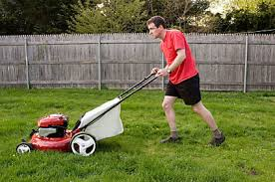
Easy solutions: just don’t do it
“The average lawn is an interesting beast: people plant it, then douse it with artificial fertilizers and dangerous pesticides to make it grow and to keep it uniform-all so that they can hack and mow what they encouraged to grow. And woe to the small yellow flower that rears its head!” Cradle to Cradle: Remaking the Way We Make Things
Creating monocultures, using electricity, pesticides, fertilisers and labour. Leaving the grass alone – increase biodiversity (flowers, incects, birds)

Slide 8
Tougher questions
Ethical: Since the future generations are not born yet and non-human species cannot speak for themselves, how can intergenerational justice and biospheric egalitarianism be addressed in democratic systems?
Practical: Can poverty reduction be decoupled from economic growth and increase in consumption of natural resources?
If the alternative path to economic development cannot be found, how can rising the standard of the living in developing countries avoid negative impacts on the global ecosystem?

Slide 9
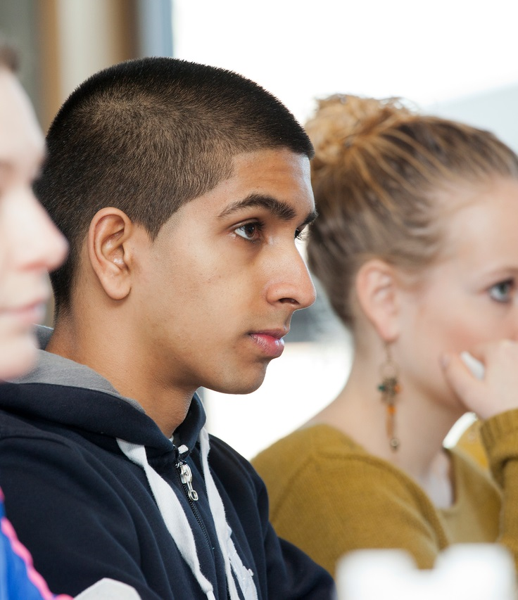
THINK. Sustainable development is NOT the same as environmental sustainability.
THERE MIGHT BE ALTERNATIVES! (and it is not SDGs)
Notes:
Let students deliberate here too

Slide 10
Alternative economies
Sharing or collaborative economy (note: doesn’t work with all products, e.g. food)
Consumer choice editing (unloved by neoliberals but effective)
Degrowth (Dan O’Neill https://www.youtube.com/watch?v=WIG33QtLRyA&t=12s)
Steady state economy (Herman Daly)
While there is legitimate critique of capitalism by neo-Marxist or anarchist scholars, the lived experience of socialism in terms of environmental protection or ecocentrism is not that different. Address industrialism, employ critical thinking and knowledge of history when thinking of alternatives.
Circular economy, Cradle to Cradle, Product to service shift: transition to services from manufacturing (note: absolute decoupling of natural resource consumption from economy in some materials is impossible due to laws of thermodynamics)

Slide 11
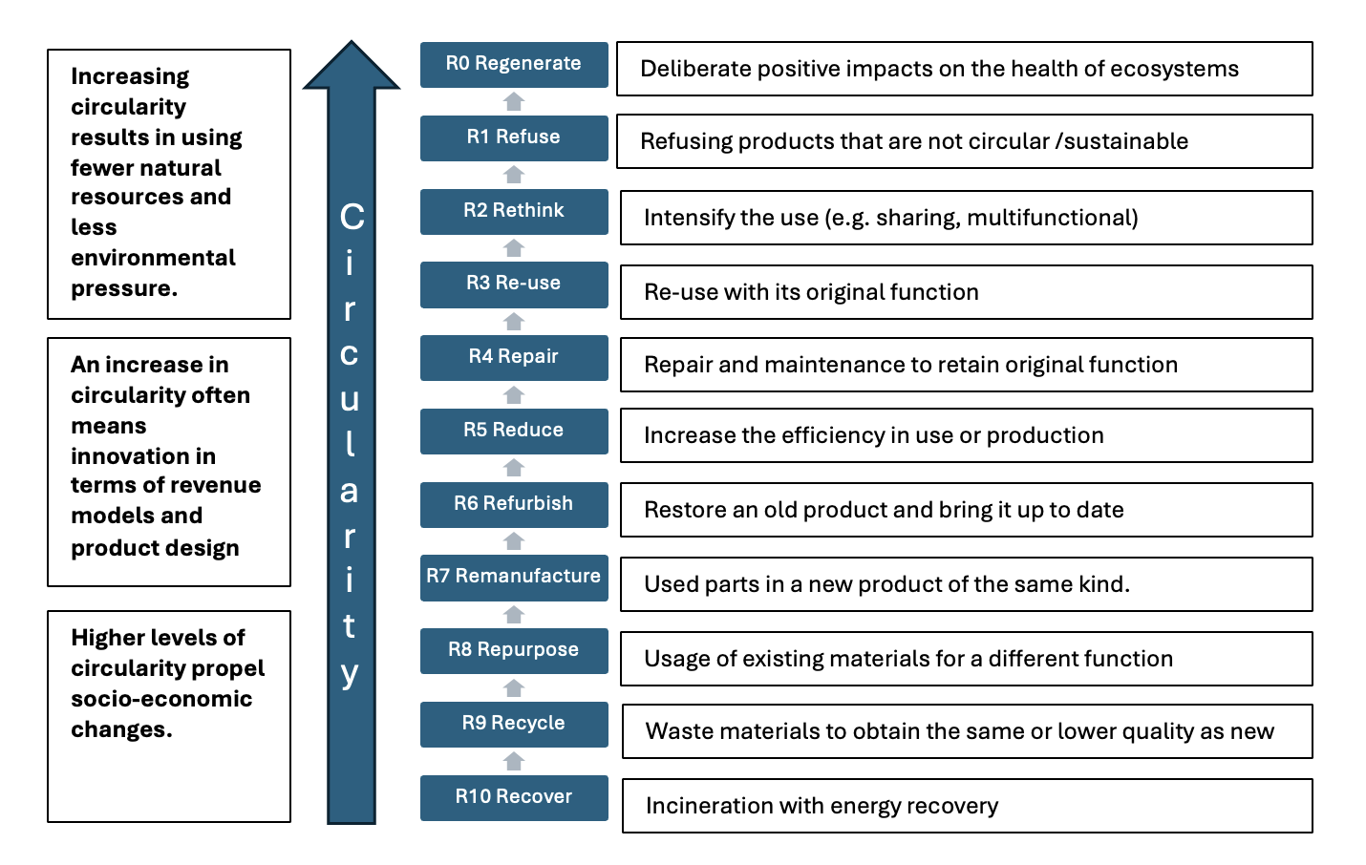
Circular economy: Revised Framework

Slide 12
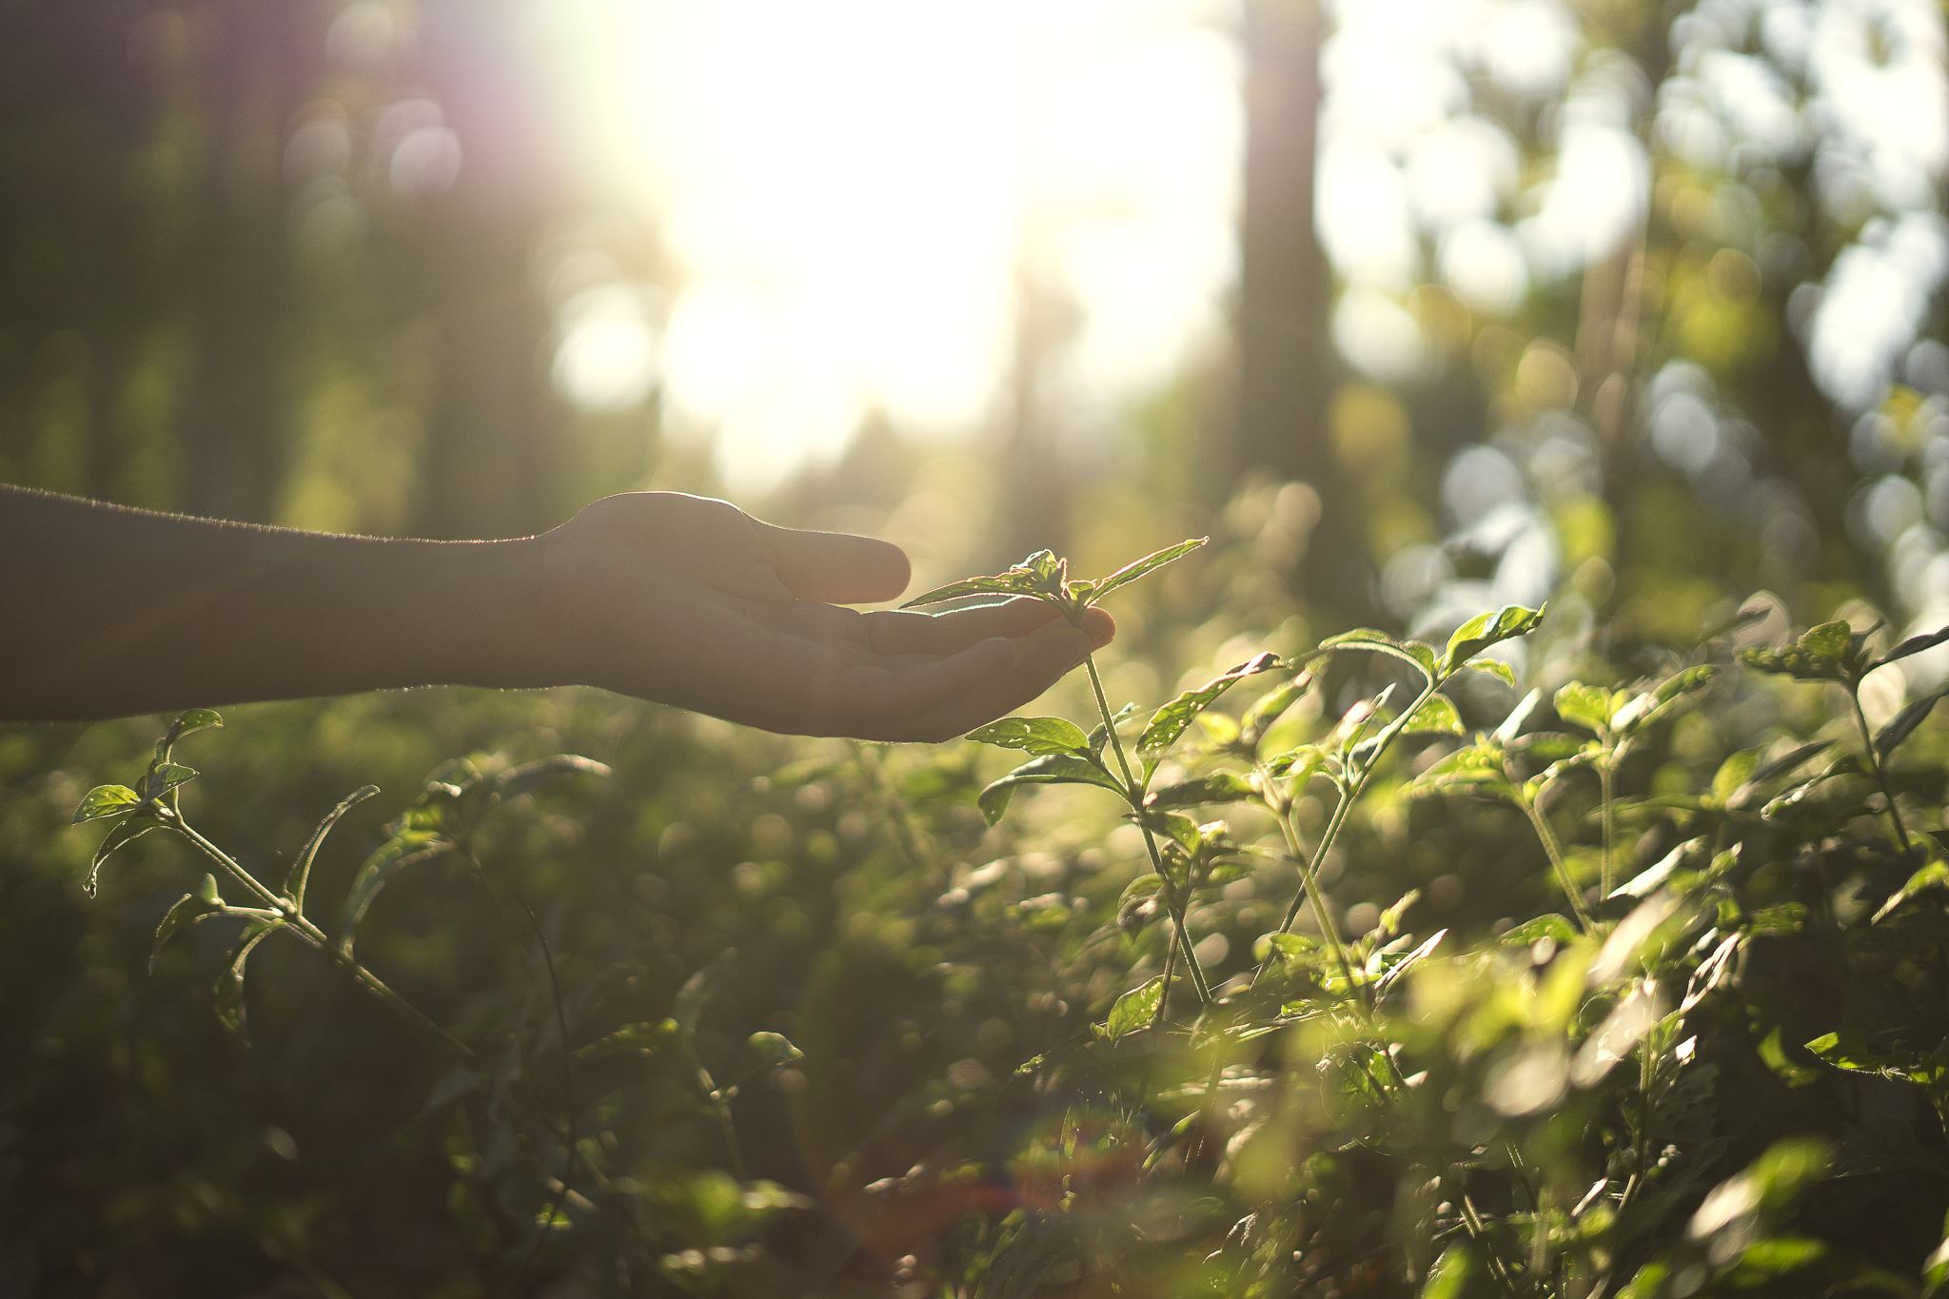
Solutions: back to environmental education
Back to eco-literacy, eco-pedagogy, and environmental education based on the limits to growth
The Tbilisi Declaration and the Belgrade charter aimed “to develop a world population that is aware of, and concerned about, the environment and its associated problems, and which has the knowledge, skills, attitudes, motivations and commitment to work individually and collectively toward solutions of current problems and the prevention of new ones” (UNESCO, UNEP 1976)
No People and Profit without Planet
INCLUSIVE GOALS to include all planetary citizens!

Slide 13
Examples of pedagogical strategies
Kopnina, H., Roca, T., Sorour, K. (2025). Integrating critical thinking about sustainable development goals: Making biodiversity matter for business students. Journal of Education for Sustainable Development. 19(1) https://doi.org/10.1177/09734082251336403
Kopnina, H., Hughes, A. C., Zhang, P., Fellinger, E., Russell, M., Smith, S., & Tickner, L. (2024). Business education and its paradoxes: Linking business and biodiversity through critical pedagogy curriculum. British Educational Research Journal. 50(6): 2712-2734 https://doi.org/10.1002/berj.4048
Kopnina, H., Black, K., Tracy, H. (2024) Ecopedagogy in business (ethics) education: Supporting ecocentric ethics in the business ethics and management curriculum. Visions for Sustainability, 22, 11280, 1-27. https://ojs.unito.it/index.php/visions/article/view/11280
Kopnina, H. (2020). Education for the future? Critical evaluation of education for sustainable development goals. Journal of Environmental Education, 51(4), 280-291. https://doi.org/10.1080/00958964.2019.1710444
https://www.linkedin.com/feed/update/urn:li:activity:7392317536568123392/

