Slide 1
GLOBAL
OBSERVATORY
FOR GENDER
EQUALITY
& SPORT
Lombé Mwambwa, PhD
CEO, Global Observatory
Post-Doc, University of Lausanne
05.02.26
genderequalitysport.org

Slide 2
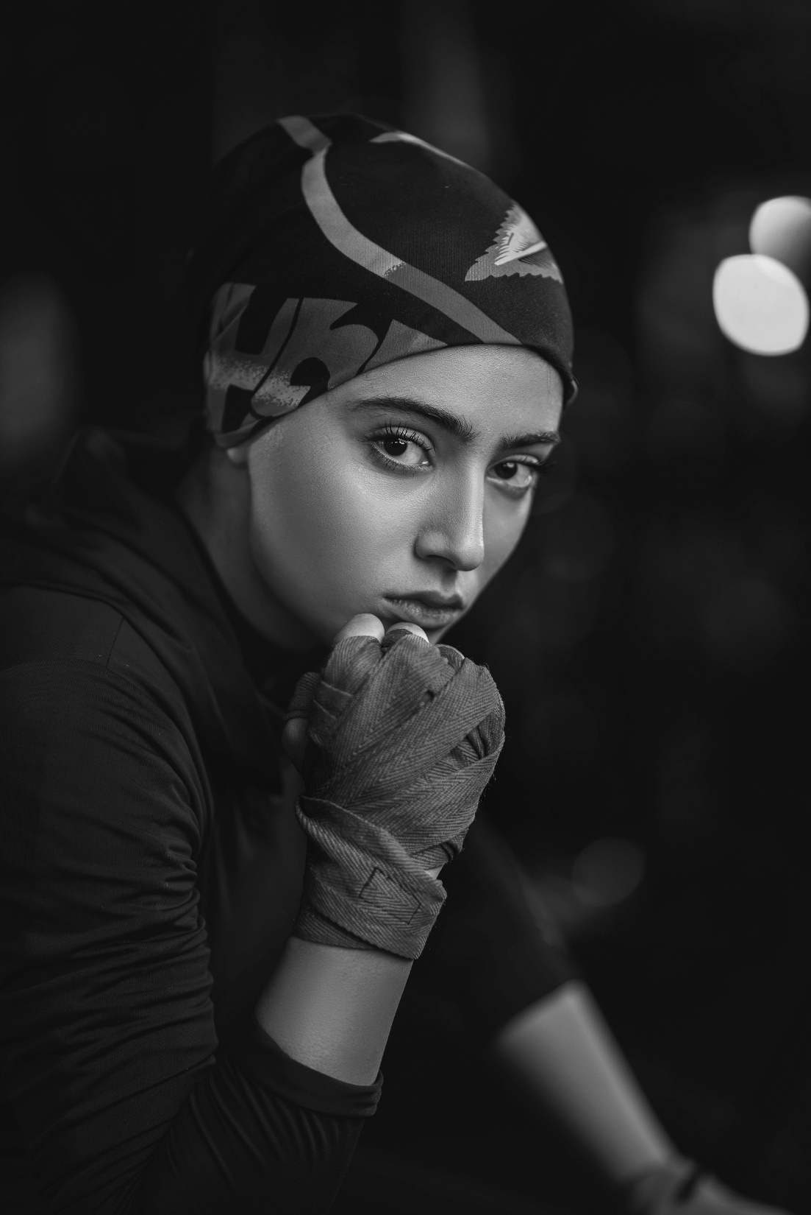

Safe and Inclusive Physical Education, Physical Activity, and Sport for Girls and Women in all their Diversity

Slide 3

Our role is to aggregate and promote sharing of data and research for policy makers and practitioners

Slide 4

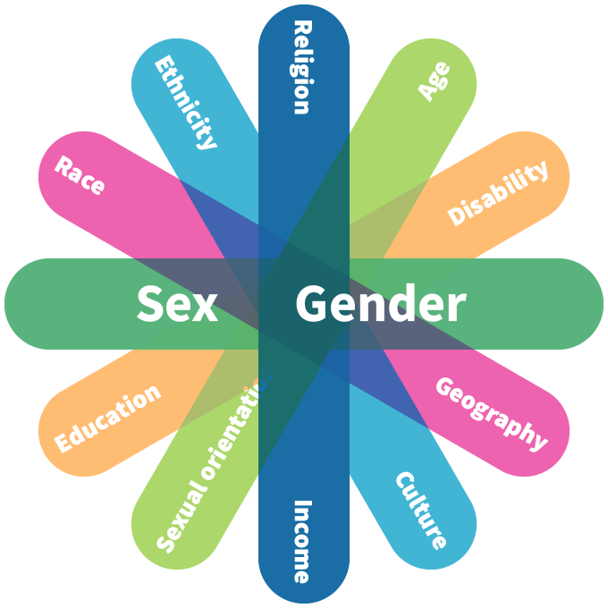
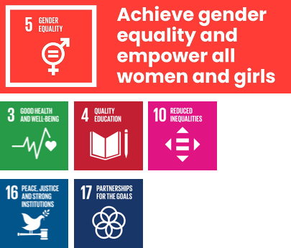
Inclusive gender equality
Girls and women in all their diversity all over the world have access to physical education, physical activity and sport in a safe and inclusive environment
4
4
(4)

Slide 5



Key Stakeholders
Academics
Universities & research experts
Sport
IFs, NGOs, Associations & Advocacy Groups
Governments & UN Agencies

Slide 6
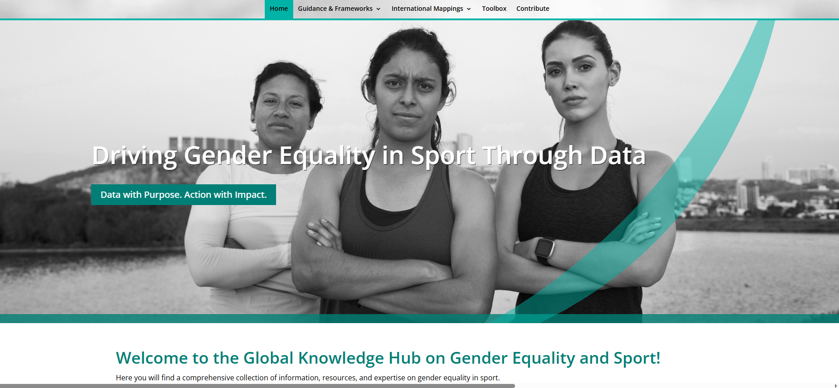
GO Knowledge Hub
data.genderequalitysport.org
Notes:
The Global Observatory Knowledge Hub on Gender Equality and Sport.
This online tool is an interactive, open, and living platform, aggregating data and research, and convening expertise.
The Knowledge Hub aims to answer three questions:
As the sporting world, are we on track with gender commitments?
Where are we investing efforts and addressing gaps in knowledge and service provision? and
What examples and guidelines do we have on what works?
In order to respond to these questions, the Knowledge Hub is structured to provide three key resources:
Guidance and Frameworks
International Mappings
Toolbox of resources
The Global Observatory collates data, resources, and expertise across six areas of concern in physical education, physical activity, and sport:
- Policy and legislative commitments and action, implementation of programmes, resources, capacity and expertise, mechanisms for coordination, reporting.
Through a suit of mappings, timelines, directories, and tools, the Knowledge hub aims to cover national state contexts and results, sport contexts, and academic and civil society action.
The Global Observatory Knowoledge Hub is a collaborate effort, we therefore invite you explore the Hub, to share it across your networks, and to contribute to its development.
Thank you for the support of its funders, experts, members, and broader stakeholders.

Slide 7
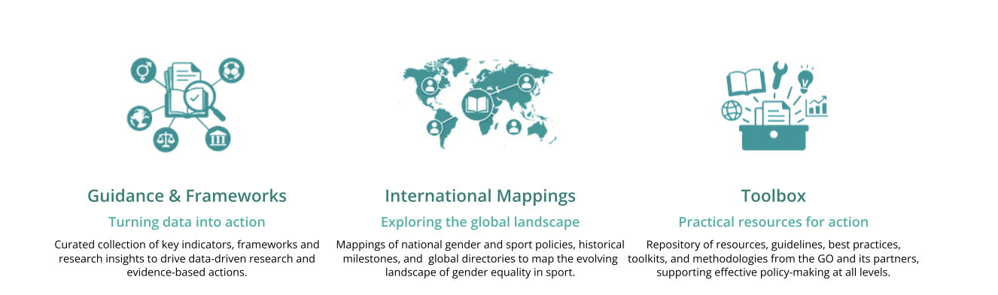
Actions

Slide 8
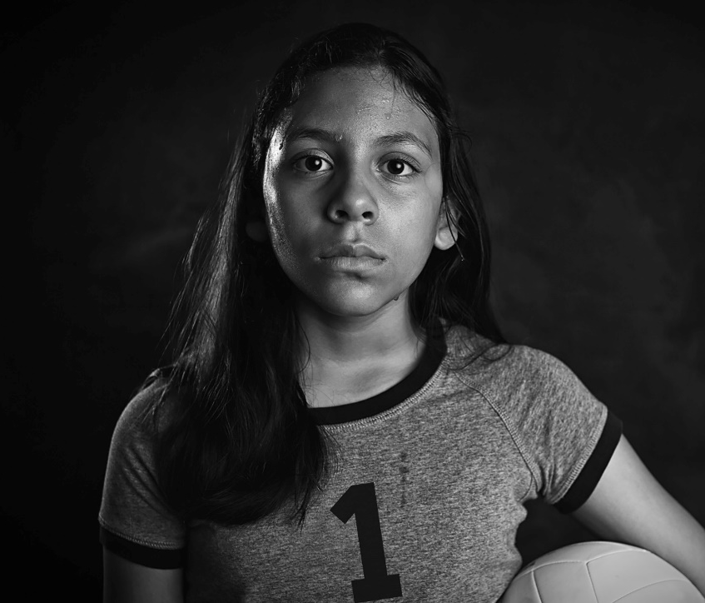
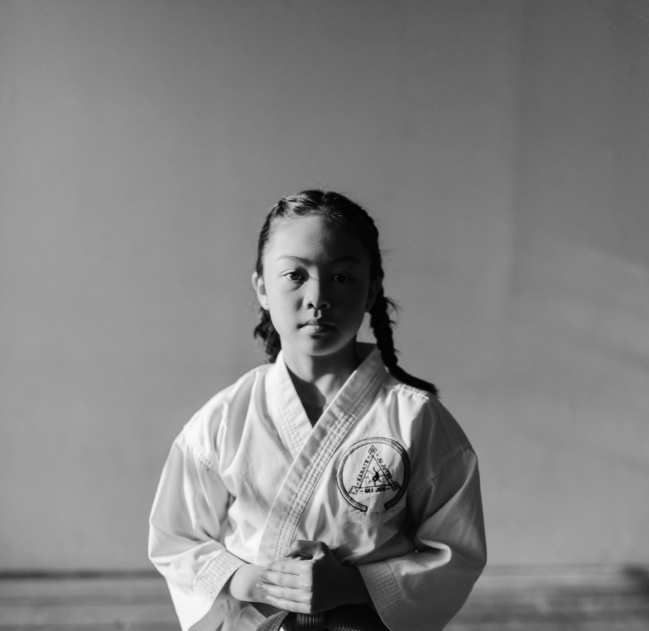
Issues on Safe and Inclusive Sport
Gender representation in leadership of sport for development and peace organisations
Participation of women and girls with albinism in sport
Participation of deaf women and girls in sport
Maternity and parenthood policies in sport organisations
GBV and Sport national policy and legislation
Notes:
The GO keeps track of emerging and endurign challenges, contexts, and experiences of women and girls in sport in order to ensure attention to issues that affects girls and women in all their diversity.

Slide 9
Challenges, Opportunities, Emerging Good Practice
Research Practice
Research Outputs
Research Engagement
Research Expertise

Slide 10

Research Practice
1
Silos and Discontinuities
2
Resource Models and Policies
3
Political Contexts

Slide 11
Gender Equality: PE, PA, Sport Policy & Legislation
Mapping Framework
4 Categories of Instruments:
- National Policies, Legislation, Action Plans, Strategies
17 Thematic Axes of Gender Equality:
- Incl: Media, Leadership, Coaching, GBV, Multistakeholder Cooperation, Monitoring etc
3 Impact Areas:
- Physical Education, Physical Activity, Sport
2 types of Frameworks and Conventions:
International and Regional
Update: Data collected on 40 countries, 12 published, 30 pending validation
Eg: Singapore

Slide 12
Observation
Power
People
Process
Possibility

Slide 13
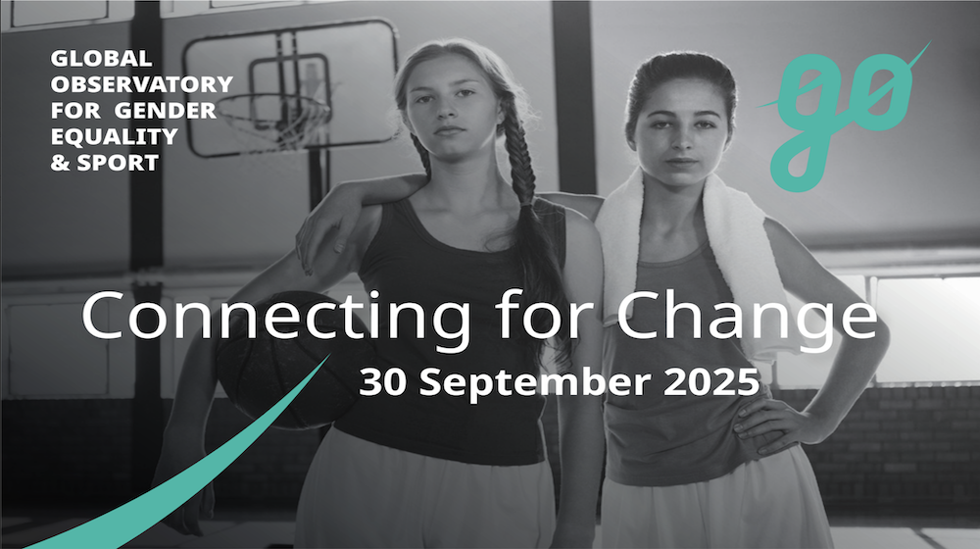

Slide 14
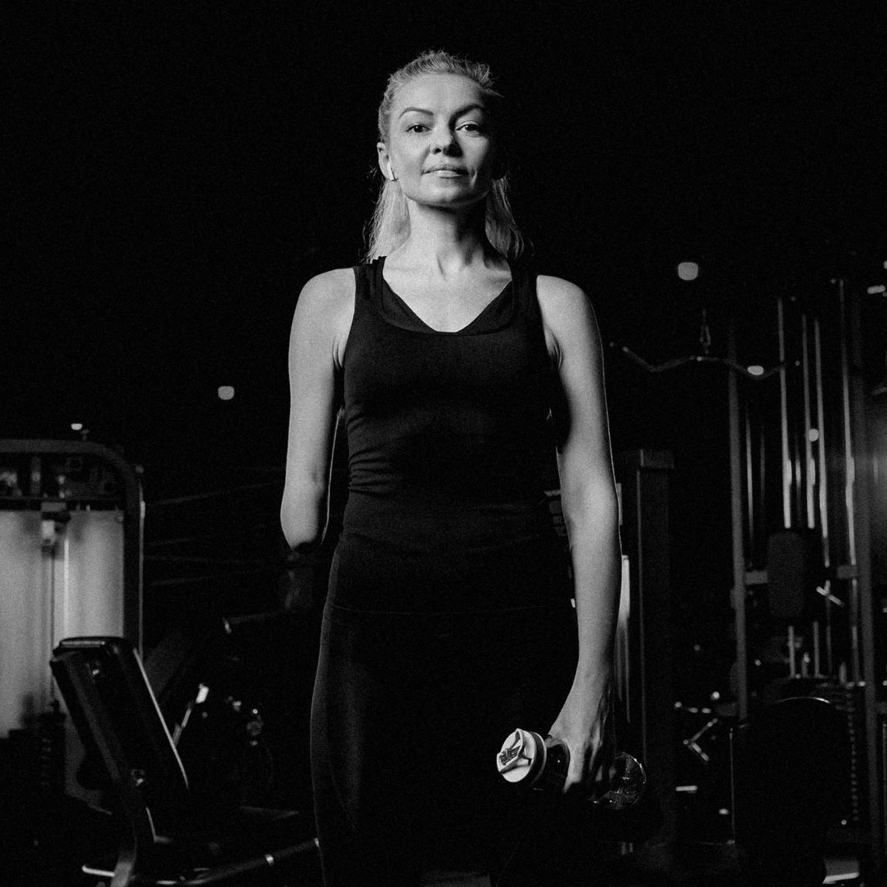
GLOBAL
OBSERVATORY
FOR GENDER
EQUALITY
& SPORT
THANK
YOU
www.genderequalitysport.org

